Slide 1
Riding the Wave: Catching Opportunities in the Post-COVID M&A Market
12th Annual Chicago Private Equity Roundtable

Slide 2




Presenters
Graeme Frazier
Andrew Greenberg
David A. Rubenstein
Adam S. Weinstock
GF Data
GF Data
Faegre Drinker
Faegre Drinker
bgf@gfdata.com
atg@gfdata.com
david.rubenstein@faegredrinker.com
adam.weinstock@faegredrinker.com

Slide 3
The most reliable source of data on private equity-backed M&A transactions in the $10 - 250 mm deal size range at multiples ranging from three to 15 times Last Twelve Months Adjusted EBITDA
More than 3,600 transactions in universe, including data on deals in more than 200 NAICS industry categories
More than 330 private equity firms have contributed data on transactions closed since January 1, 2003
PE contributors and other subscribers receive quarterly valuation and leverage data reports, detailed key deal terms data (e.g., indemnity caps and baskets and escrow/holdback amounts) and continuous access to the online searchable data base
For subscription info, contact Bob Wegbreit +1 610 616 4607 bw@gfdata.com

Slide 4
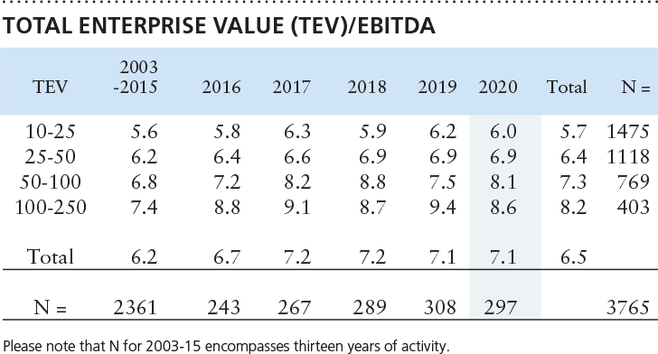
Valuation Overview
SOURCE: GF DATA ®
Permission to reprint or distribute any content copyrighted by GF Data® requires consent from GF Data Resources LLC.

Slide 5
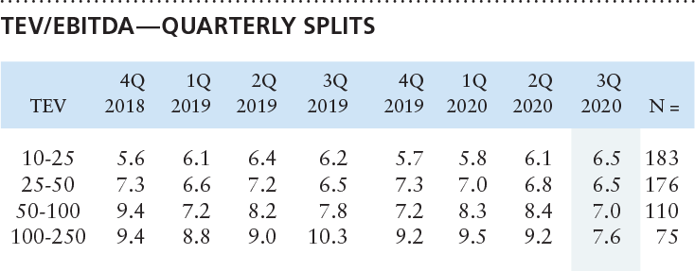

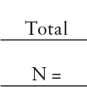
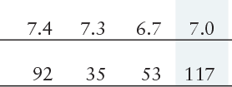
Valuation Overview
SOURCE: GF DATA ®
Permission to reprint or distribute any content copyrighted by GF Data® requires consent from GF Data Resources LLC.

Slide 6
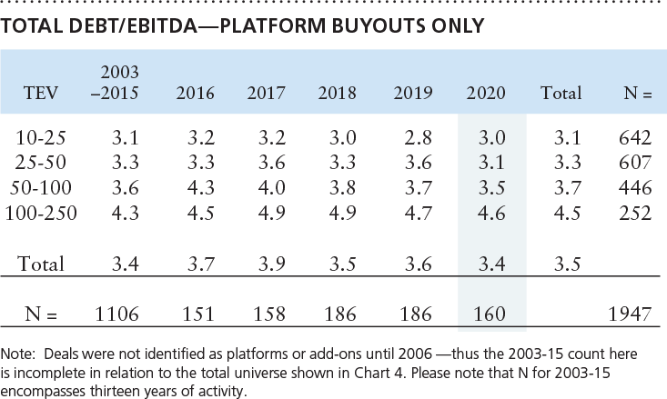
Leverage Report
SOURCE: GF DATA ®
Permission to reprint or distribute any content copyrighted by GF Data® requires consent from GF Data Resources LLC.

Slide 7
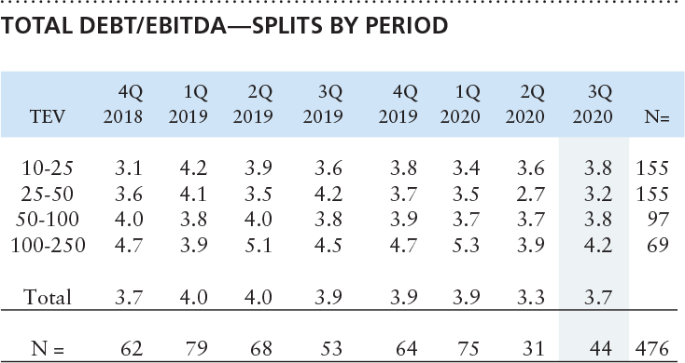

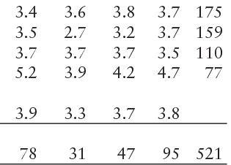
Debt Levels
SOURCE: GF DATA ®
Permission to reprint or distribute any content copyrighted by GF Data® requires consent from GF Data Resources LLC.

Slide 8
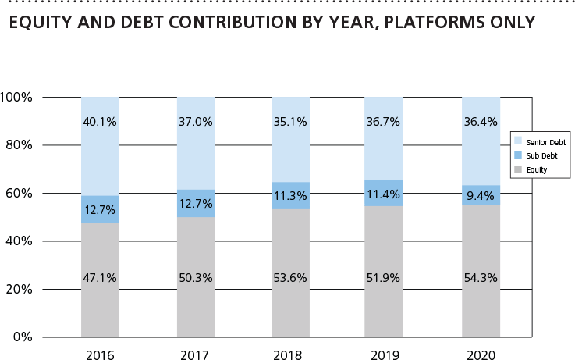
Leverage Report
SOURCE: GF DATA ®
Permission to reprint or distribute any content copyrighted by GF Data® requires consent from GF Data Resources LLC.

Slide 9

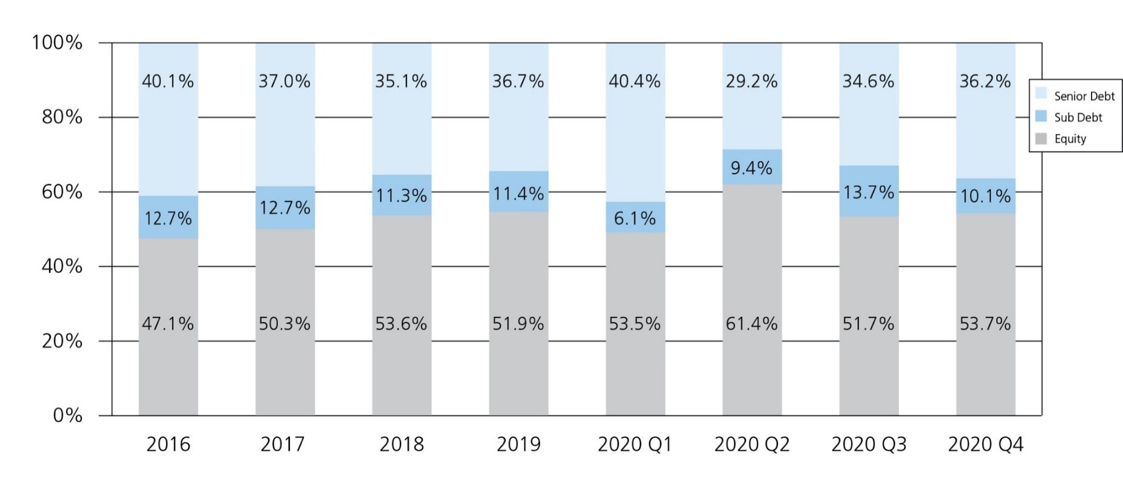
Leverage Report
SOURCE: GF DATA ®
Permission to reprint or distribute any content copyrighted by GF Data® requires consent from GF Data Resources LLC.

Slide 10
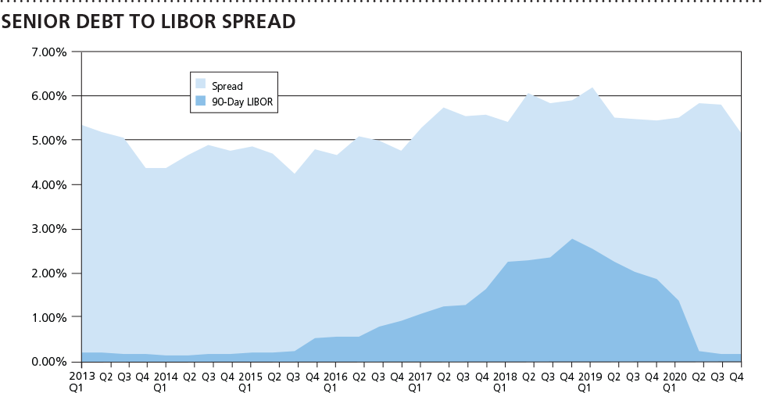
Leverage Report
SOURCE: GF DATA ®
Permission to reprint or distribute any content copyrighted by GF Data® requires consent from GF Data Resources LLC.

Slide 11
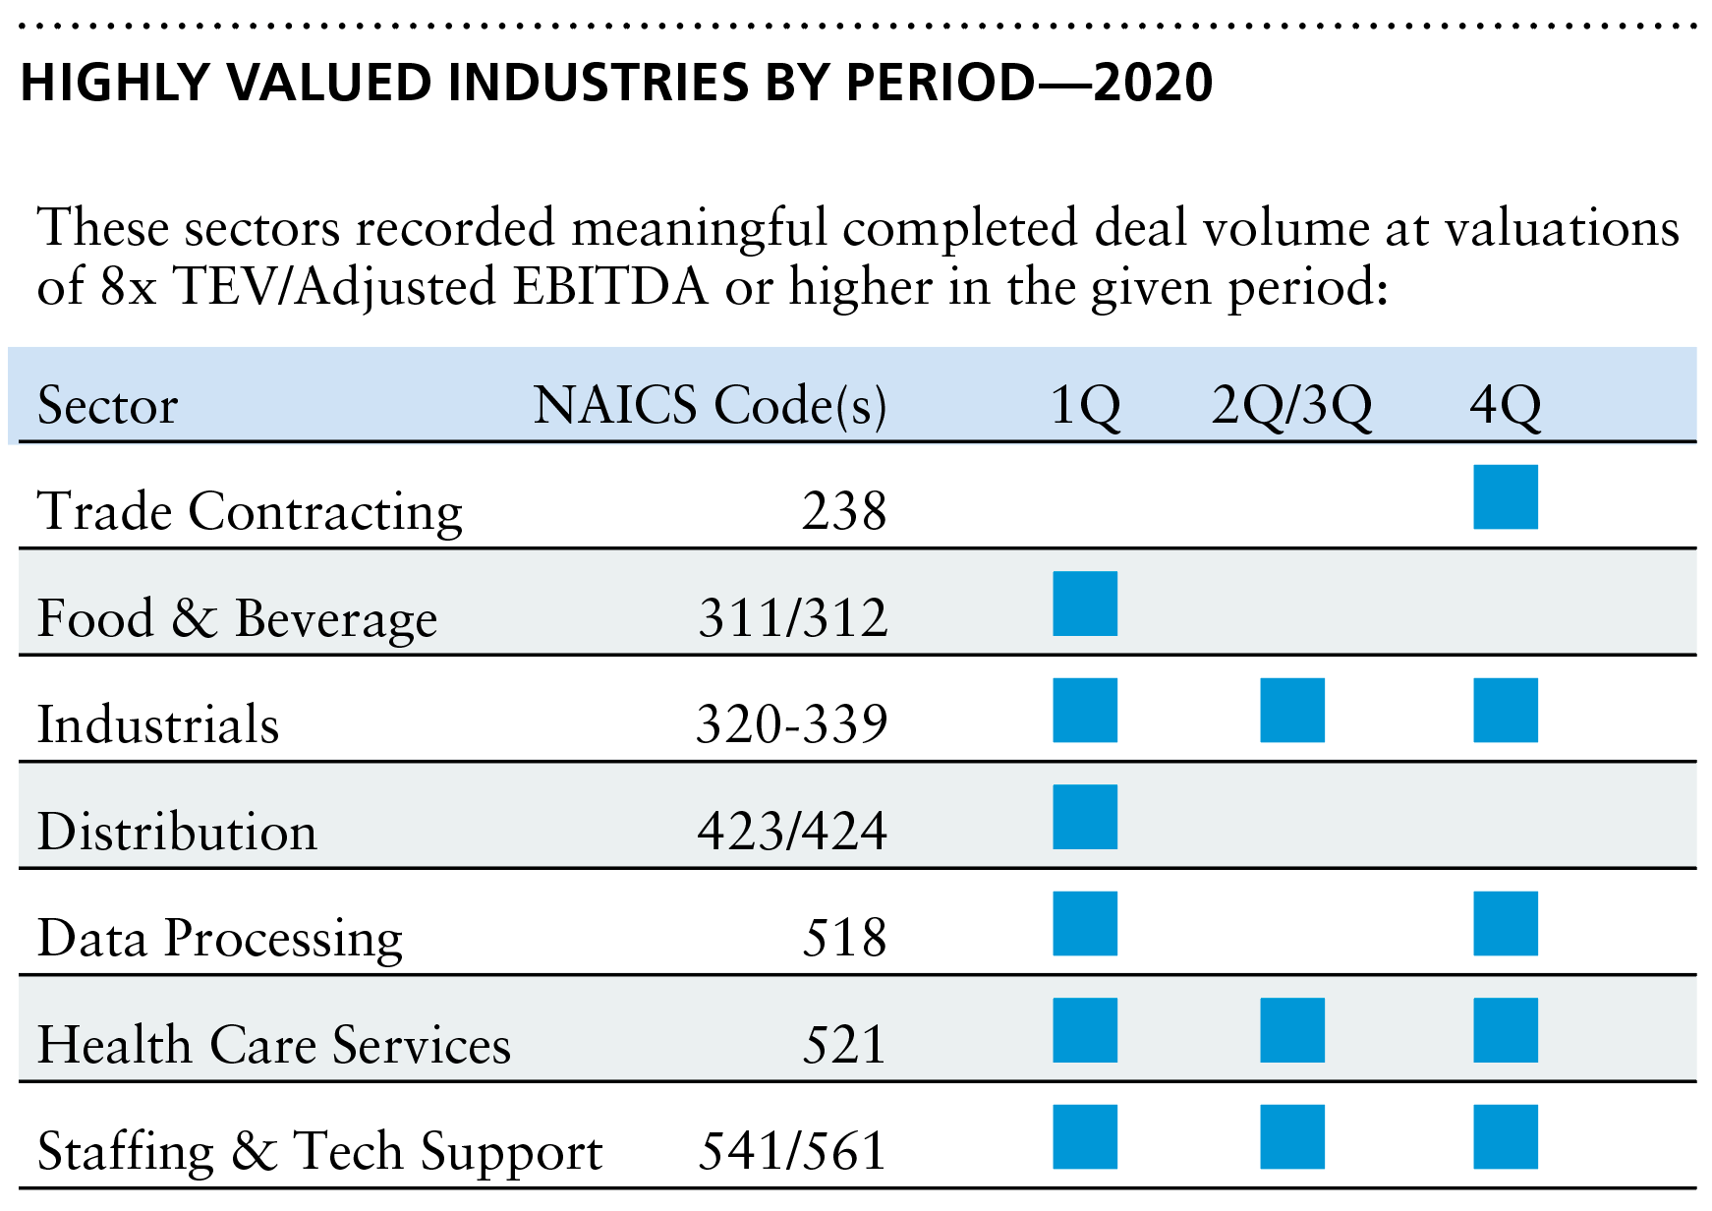
Valuation Overview
SOURCE: GF DATA ®
Permission to reprint or distribute any content copyrighted by GF Data® requires consent from GF Data Resources LLC.

Slide 12
Group Discussion

Slide 13
Thank You for Attending!
The attendee roster is available to download under the ‘File/Menu’ tab at the top left of your screen.
If a question you asked did not get answered during the live webcast, one of the presenters will answer your question via email.

