Slide 1
U.S. Supreme Court
October Term 2019 Preview
John Baker
Sybil Dunlop
Jeff Justman
Aaron Van Oort
Moderated by: Hon. David R. Stras
October 17, 2019

Slide 2
Overview
High-profile cases in:
  Constitutional Law
  Jurisdiction and Procedure
  Federal Statutes
  Criminal Law and Procedure
  Intellectual Property

Slide 3
Constitutional Law

Slide 4

First & Fourteenth Amendments
Espinoza v. Montana Dep’t of Rev
  Whether it violates the religion clauses or the equal protection clause of the United States Constitution to invalidate a generally available and religiously neutral student-aid program simply because the program affords students the choice of attending religious schools.

Slide 5
Split of Authority
Violation to Exclude | No Violation to Exclude
6th Circuit (1995) – child-care program | 1st Circuit (1999) – scholarship program
7th Circuit (2010) – student organization funding | 9th Circuit (1999) – special ed. benefits
8th Circuit (1998) – special ed. benefits | Maine (1999) – school voucher program
10th Circuit (2008) – scholarship program | Vermont (1999) – school voucher program
New Mexico (2019) – textbook loan program | Montana (2018) – scholarship program

Slide 6
Supreme Court weighs in…
Locke v. Davey (2004)
  Can Washington state exclude theology students from college scholarship program without violating the Free Exercise Clause?
  Held (7-2): Yes. States have “historic and substantial interest” in not directly funding religious instruction.
Trinity Lutheran Church v. Comer (2017)
  Can Missouri deny playground grant to otherwise-qualifying church daycare?
  Held (7-2): No. States may not deny organizations participation in a widely available public program based on religious status.
Espinoza v. Montana Dep’t of Revenue
  Can the Montana Dept. of Revenue exclude religiously affiliated schools from scholarship program for low-income students?

Slide 7
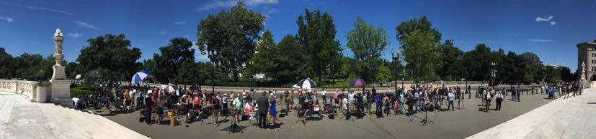
Reproductive Rights/Abortion
June Medical Services LLC v. Gee
  Clinic: Whether the 5th Circuit’s decision upholding Louisiana’s law requiring physicians who perform abortions to have admitting privileges at a local hospital conflicts with Whole Woman’s Health v. Hellerstedt (2016) (striking down Texas law)
  Louisiana: Whether providers can be presumed to have third-party standing to challenge health & safety regulations on behalf of their patients, absent a close relationship and hinderance of patients’ ability to sue on their own behalf.

Slide 8
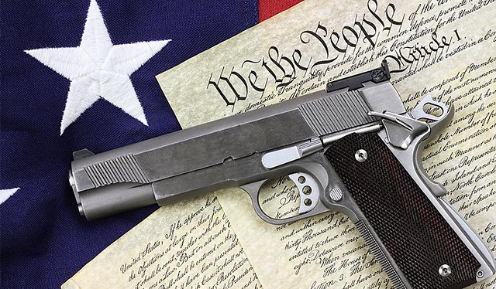
Second Amendment
New York State Rifle & Pistol Association v. New York
  Whether New York City’s ban on transporting a licensed, locked and unloaded handgun to a home or shooting range outside city limits violates the Second Amendment, the commerce clause, and the constitutional right to travel.

Slide 9
Federal Statutes

Slide 10

Title VII Discrimination
Title VII
  Title VII of Civil Rights Act of 1964 prohibits employment discrimination “because of . . . sex.”
  What does this include?

Slide 11

Title VII Discrimination
Sexual Orientation?
  Altitude Express Inc. v. Zarda
    Skydiving instructor let go allegedly because he was gay
  Bostock v. Clayton County, GA
    Child-welfare-services coordinator let go allegedly because he was gay, under guise of mismanaging public money

Slide 12
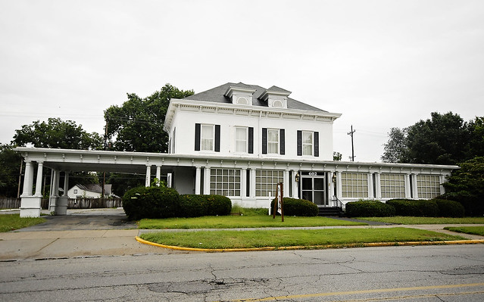
Title VII Discrimination
Transgender Status?
  R.G. & G.R. Harris Funeral Homes v. EEOC
    Funeral director let go after changing gender status from male to female and wanting to wear women’s clothes to work

Slide 13

Affordable Care Act
Consolidated cases
  Moda Health Plan v. U.S.
  Maine Community Health Options v. U.S.
  Land of Lincoln Mutual Health Insurance Co. v. United States
Issue: Bait-and-switch?
  Can Congress can evade its unambiguous statutory promise to pay health insurers for losses already incurred simply by enacting appropriations riders that restrict the sources of funds available to satisfy the government’s obligation?
    “Cardinal rule” against implied repeals

Slide 14
Jurisdiction & Procedure

Slide 15

ERISA Pleading Standard
Retirement Plans Committee of IBM v. Jander
  Whether the “more harm than good” pleading standard under Fifth Third Bancorp v. Dudenhoeffer can be satisfied by generalized allegations that the harm of an inevitable disclosure of an alleged fraud generally increases over time?
    ERISA fiduciary duty of prudence
Minnesota examples:
  Dormani v. Target Corp. (D. Minn. 2018)
  In re Wells Fargo ERISA 401(k) Litigation (D. Minn. 2018)

Slide 16

Statutes of Limitations

Slide 17
Statutes of Limitations
What is “actual knowledge” for ERISA claims?
  Intel Corp. Investment Policy Committee v. Sulyma
    Whether the 3-year ERISA limitations period bars suit when all the relevant information was disclosed to the plaintiff by the defendants more than three years before the plaintiff filed the complaint, but the plaintiff chose not to read or could not recall having read the information.
Does the “discovery rule” apply to FDCPA claims?
  Rotkiske v. Klemm
    Whether the “discovery rule” applies to toll the 1-year statute of limitations under the FDCPA.

Slide 18

DACA and the APA

Slide 19
DACA and the APA
Consolidated cases
  Trump v. NAACP
  McAleenan v. Vidal
  Dept. Homeland Security v. Regents of the Univ. of California
Issues
  (1) Whether the Department of Homeland Security’s decision to wind down the Deferred Action for Childhood Arrivals policy is judicially reviewable.
  (2) Whether DHS’s decision to wind down the DACA policy is lawful.
    Arbitrary and capricious?
    Violates equal protection and due process?
  (continued)

Slide 20
DACA and the APA
(1) Judicially reviewable?
  D.C. District Court: Yes
    5 U.S.C. § 701(a)(2) does not insulate agency decisions to rescind “a general enforcement policy predicated on [a] legal determination that the program was invalid”
    Judicial review need not wait for a final removal order when no removal proceedings against DACA recipients have begun
(2) Lawful agency decision?
  D.C. District Court: No
    DHS decision was not subject to notice-and-comment rulemaking as general statement of agency policy
    BUT decision was arbitrary and capricious because it inadequately explained legal rationale and failed to consider reliance interests
    Defers constitutional challenges

Slide 21
Criminal Law and Procedure

Slide 22
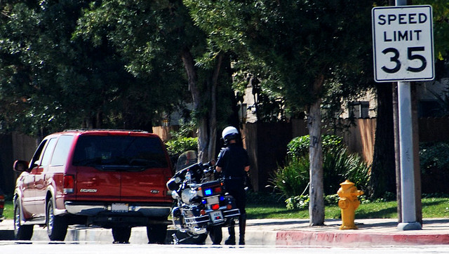
Fourth Amendment
Kansas v. Glover
  Whether, for purposes of an investigative stop under the Fourth Amendment, it is reasonable for an officer to suspect that the registered owner of a vehicle is the one driving the vehicle absent any information to the contrary.

Slide 23
State . . . split?
Yes | No
Indiana | Kansas
Iowa
Maine
Minnesota
Montana
New Hampshire
New Jersey
Vermont
Wisconsin
5th Circuit
6th Circuit
8th Circuit
10th Circuit

Slide 24

Sixth Amendment
Ramos v. Louisiana
  Whether the 14th Amendment fully incorporates the Sixth Amendment guarantee of a unanimous verdict.
    10-2 verdict; life without parole (2016)
    (continued)

Slide 25
Sixth Amendment
Background
  Jim Crow remnant?
    “Our mission was, in the first place, to establish the supremacy of the white race in this State to the extent to which it could be legally and constitutionally done.” – Closing remarks at 1898 Louisiana Constitutional Convention
  Apodaca v. Oregon (1972) (Powell, J.) - Constitution requires unanimous jury in federal but not in state court
Who’s left?
  Louisiana referendum ends non-unanimous juries on Nov. 6, 2018
  Only Oregon left

Slide 26
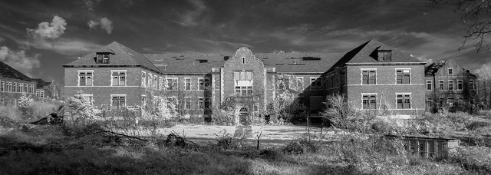
Eighth Amendment
Kahler v. Kansas
  Whether the Eighth and Fourteenth Amendments permit a state to abolish the insanity defense.
    Kansas, Idaho, Montana, Utah have abolished insanity defense

Slide 27
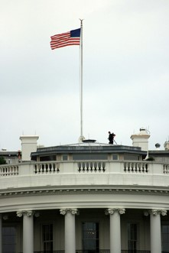
Eighth Amendment
Mathena v. Malvo
  Does the Constitution prohibit discretionary life sentences without parole for minors?
    2002 “D.C. sniper” Malvo, age 17, sentenced to life in prison without parole
    Miller v. Alabama (2012) bars mandatory life sentences without parole for minors
    Montgomery v. Louisiana (2016) applies Miller retroactively
  Does Montgomery expand Miller to discretionary sentences?
    4th Circuit: Yes
    Virginia: No
  New sentencing for Malvo?

Slide 28

First Amendment - Alienage
U.S. v. Sineneng-Smith
  It is a felony to “encourage or induce,” for private financial gain, an alien to remain in the U.S. if the encourager knew, or recklessly disregarded the fact that remaining here is illegal. (8 U.S.C. 1324(a)(1)(A)(iv))
  Defendant helped alien clients get work permits even after the program expired
  9th Cir.: The statute is facially overbroad in violation of the 1st Amendment.
    Its sweep reaches a substantial amount of protected expression (“abstract advocacy”) compared to the narrow band of unprotected expression it prohibits.

Slide 29
Intellectual Property

Slide 30

Intellectual Property
Peter v. NanKwest

Slide 31
Intellectual Property
Peter v. NanKwest
“Whether the phrase ‘[a]ll the expenses of the proceedings’ in 35 U.S.C. 145 encompasses the personnel expenses the USPTO incurs when its employees, including attorneys, defend the agency in Section 145 litigation.”
Amici supporting NantKwest include the ABA, the IPO, AIPLA, the IEEE-USA, and the International Trademark Association.

Slide 32

Intellectual Property
Thryv v. Click-to-Call Technologies
  What does “nonappealable” mean in the AIA trial context?

Slide 33

Intellectual Property
Lucky Brand Dungarees v. Marcel Fashions Group
Issue: Whether, when a plaintiff asserts new claims, federal preclusion principles can bar a defendant from raising defenses that were not actually litigated and resolved in any prior case between the parties.

Slide 34

The End
Faegre BD

