Slide 1
U.S. Supreme Court
October Term 2018 Preview
Hon. David Stras
John Baker
Sybil Dunlop
Jeff Justman
Aaron Van Oort
November 14, 2018

Slide 2
Overview
Kennedy/ Kavanaugh
  Statistics
  Stare Decisis
High-profile cases in:
  Constitutional Law
  Intellectual Property
  Jurisdiction and Procedure
  Criminal Law and Procedure

Slide 3


Slide 4
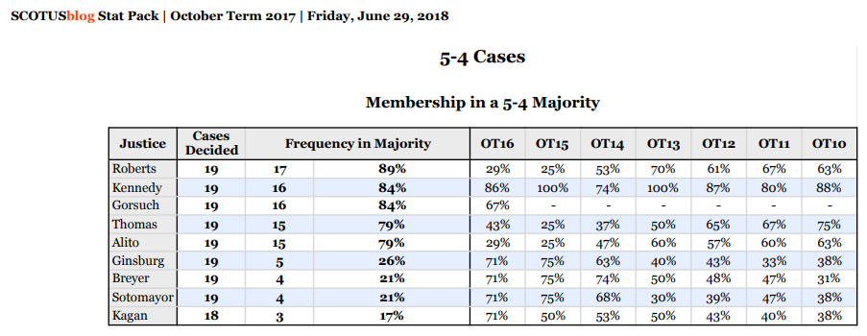

Slide 5
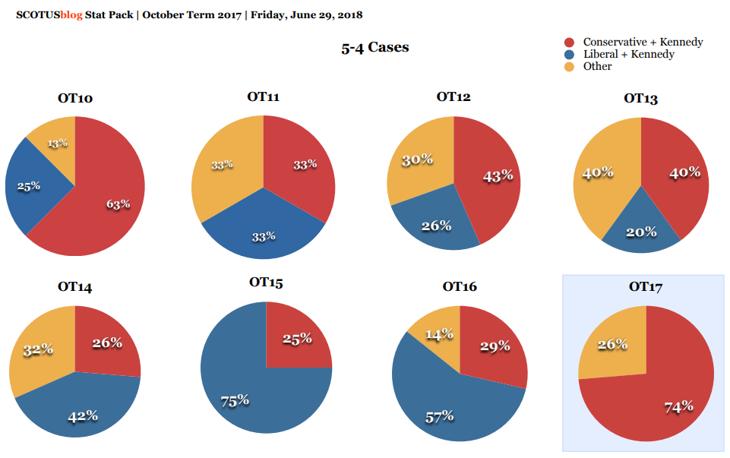

Slide 6


Slide 7
Stare Decisis

Slide 8

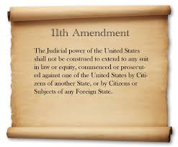
Stare Decisis
Gamble v. U.S.
  Should the separate-sovereigns exception to the double jeopardy clause be overruled?
Franchise Tax Board of California v. Hyatt
  Should Nevada v. Hall, which permits a sovereign state to be haled into another state’s courts without its consent, be overruled?

Slide 9
The Decisive Vote?
Bucklew v. Precythe
  Whether the Eighth Amendment requires an inmate to prove an adequate alternative method of execution when raising an as-applied challenge to the state’s proposed method of execution based on his rare and severe medical condition
At oral argument:
  “Are you saying even if the method creates gruesome and brutal pain you can still do it because there’s no alternative?”
  “Your opposing counsel said, even if everything goes according to plan, there will still be significant suffering. Can you respond to that?”

Slide 10
Constitutional Law

Slide 11
Takings Clause
Knick v. Township of Scott:
  Should language in the Fifth Amendment’s Takings Clause limiting it to takings “without just compensation” continue to require takings plaintiffs to first try to obtain compensation under reasonable state-law remedies, in order to “complete” or “ripen” a federal takings claim?
    Since 1890, the Court has generally held that Takings Clause is not violated by a taking without pre-payment, but only by a taking without certain and adequate provision for obtaining compensation
    Lately known as “Williamson County prong two” requirement
    Federal facial challenge to cemetery-access ordinance “not ripe”
  Argued Week One, before J. Kavanaugh joined the Court
  Nov. 2: re-argument ordered, plus further briefing of a subissue

Slide 12
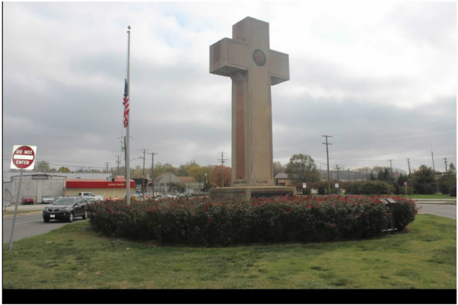
Md. Nat’l Capital Park & Planning Comm’n v. AHA

Slide 13
First Amendment – Establishment Clause
Maryland-National Capital Park & Planning Commission v. American Humanist Association:
  Does the Establishment Clause of the First Amendment require the removal or destruction of a 93-year-old memorial to American servicemen who died in World War I because the memorial bears the shape of a cross?
    40-foot “Latin cross” in traffic circle, as part of park trail area that included several smaller memorials to wars and other tragedies
  What test should be used to determine the constitutionality of a passive display incorporating religious symbolism; and if the Lemon test, is this excessive entanglement with religion?
    Van Orden 4-justice majority opinion: Lemon test “not useful” in the context of passive monuments.
    Van Orden concurrence of J. Breyer: Lemon test continues to be a useful guidepost in Establishment Clauses cases, including for monuments

Slide 14
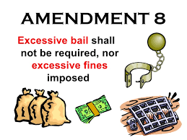
Eighth Amendment
Timbs v. Indiana
  Is the Eighth Amendment’s Excessive Fines Clause incorporated against the states through the Fourteenth Amendment?
    2001 dictum in Cooper Indus. v. Leatherman Tool Group: “yes”
    2010 dictum in McDonald v. City of Chicago: “no”
    Civil forfeiture of heroin dealer’s Land Rover
    Indiana state courts split
    Ind. S. Ct. follows latest dictum

Slide 15
Intellectual Property

Slide 16


Slide 17


Slide 18

Patents
Return Mail Inc. v. U.S. Postal Service.
  Whether the government is a “person” who may petition to institute review proceedings under the Leahy-Smith America Invents Act.

Slide 19

Patents
Helsinn Healthcare S.A. v. Teva Pharmaceuticals USA Inc.
  Whether, under the Leahy-Smith America Invents Act, an inventor’s sale of an invention to a third party that is obligated to keep the invention confidential qualifies as prior art for purposes of determining the patentability of the invention.

Slide 20
Jurisdiction and Procedure

Slide 21

Arbitration
New Prime Inc. v. Oliveira
  Is the applicability of FAA Section I’s exemption a question of arbitrability that courts must decide, and does the “contracts of employment” exemption apply to independent contractor agreements?
Lamps Plus Inc. v. Varela
  Does the FAA foreclose a state-law interpretation of an arbitration agreement that would authorize class arbitration based solely on general language commonly used in arbitration agreements?
Henry Schein Inc. v. Archer and White Sales Inc.
  Does the FAA permit a court to decline to enforce an agreement delegating questions of arbitrability to an arbitrator if the court concludes the claim of arbitrability is “wholly groundless.”

Slide 22

Class Actions
Frank v. Gaos
  When, if at all, does a cy pres award of class action proceeds that provides no direct relief to class members support class certification and comport with the requirement that a settlement binding class members must be “fair, reasonable, and adequate””
Nutraceutical Corp. v. Lambert
  Did the 9th Circuit err when it held that equitable exceptions apply to Rule 23(f)’s deadline to file a petition for permission to appeal an order granting or denying class-action certification?
Home Depot U.S.A. Inc. v. Jackson
  Whether, under the Class Action Fairness Act, an original defendant to a class-action claim that was originally asserted as a counterclaim against a co-defendant can remove the class action to federal court if it otherwise satisfies CAFA, and whether the holding in Shamrock Oil & Gas Co. v. Sheets -- that an original plaintiff may not remove a counterclaim against it -- extends to third-party counterclaim defendants.

Slide 23
Criminal Law and Procedure

Slide 24

Non-Delegation Doctrine
Gundy v. U.S.
  Does the federal Sex Offender Registration and Notification Act’s delegation of authority to the attorney general to issue regulations under 42 U.S.C. § 16913 violate the nondelegation doctrine?

Slide 25
Sixth Amendment
Garza v. Idaho.
  Is a criminal defendant’s counsel presumptively ineffective if counsel declines to file an appeal of a conviction because the defendant already waived the right to appeal in his plea?

