Slide 1


Privacy/Security Litigation Update
Jeff Justman
Joe Hashmall

Slide 2
Data Breach Litigation
Trends in Data Breach Cases
High-Level Tour of Recent Circuit Court Decisions:
  Muransky v. Godiva Chocolatier, Inc., 905 F.3d 1200, 1212 (11th Cir. 2018)
  In re Zappos.com, Inc., 888 F.3d 1020 (9th Cir. 2018)
  Hutton v. Nat’l Bd. of Examiners in Optometry, Inc., 892 F.3d 613 (4th Cir. 2018)
  Community Bank of Trenton v. Schnuck Markets, 887 F.3d 803 (7th Cir. 2018)
  Dieffenbach v. Barnes & Noble, Inc., 887 F.3d 826 (7th Cir. 2018)
  Kuhns v. Scottrade, Inc., 868 F.3d 711, (8th Cir. 2017)
  In re Supervalu, Inc. Customer Data Security Breach Litigation, 870 F.3d 763, (8th Cir. 2017)
Top 10 Take-Aways

Slide 3
Data Breach Litigation Trends
Courts more frequently allowing cases to proceed against challenges for lack of standing at the Rule 12 stage
  2013-2015: many courts dismissed these cases
  2016-2018: more courts allowing lawsuits to proceed
Different types of alleged harm suffice for standing purposes
  Time value of money
  Costs incurred, even if reimbursed
Focus of defenses to data breach cases is turning to the merits of the individual claims alleged
  Lack of injury under state law
  Other procedural defenses
Higher public profile leads to individual litigation
  $7,000 jury verdict against Equifax in Hennepin County

Slide 4
Muransky v. Godiva Chocolatier, Inc.
Plaintiffs sued Godiva for violation of FACTA, alleging too many digits printed on receipt.
After settlement, objector appealed, challenging standing.
11th Circuit found standing based on risk of harm, and the fact that class members must spend “time (and wallet space) to safely dispose of or keep the untruncated receipt so as to avoid someone finding their credit card number on their receipt.”

Slide 5
In re Zappos.com, Inc.
Customers of Zappos had some PII stolen in a data breach—up to 24 million customers’ PII was affected
Some of the Plaintiffs alleged a substantial risk of future injury because (i) some of their credit card information was taken (even if it hadn’t been used to commit identity theft); and (ii) other plaintiffs had been the subject of fraud and identity theft, underscoring the risk to these Plaintiffs
Ninth Circuit: allegations satisfied all requirements of the standing inquiry; challenges to causation is “more about the merits of causation and damages”

Slide 6
Dieffenbach v. Barnes & Noble
Barnes & Noble PIN pad information was compromised, customer information, card numbers, and PINs stolen. Customers lost the use of their funds, some spent money on credit-monitoring services, some lost the value of their time acquiring new account numbers.
Seventh Circuit: dismissing on standing grounds so early is a “new label for an old error.” The theft may have caused customers to pay more, they lost the time-value of money, that’s enough for standing.
But: standing might still not suffice to prove injury under state law. And it is far from clear that such suits “should be certified as a class action; both the state laws and the potential damages are disparate.”

Slide 7
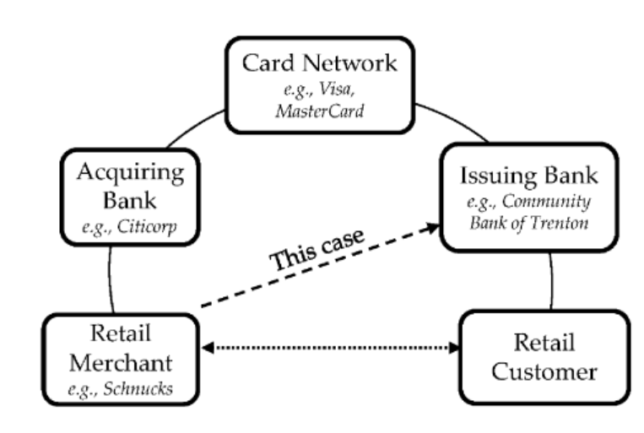
Community Bank of Trenton v. Schnuck’s Markets
Schnuck’s Markets is a grocery store chain. Hackers stole 2.4 million credit and debit cards of Schnuck’s customers.
New wrinkle: financial institutions are the plaintiffs. Banks and credit unions are required to indemnify card-holding customers from losses due to fraudulent activity. Banks filed suit against Schnuck’s seeking remedies beyond those set forth in contracts
Seventh Circuit: banks are limited
to remedies in contracts governing
card payment systems.

Slide 8
Hutton v. Nat’l Bd. of Examiners in Optometry, Inc.
Lots of optometrists noticed that credit card accounts were fraudulently opened in their names. But the NBEO never acknowledged a breach; it just posted a cryptic message.
District court dismissed the case for lack of Article III standing, because no fraudulent charges had been incurred and no higher interest rates had been applied or credit otherwise declined.
Fourth Circuit: mere increased risk of future identity theft and the cost of measures to protect against it isn’t enough; but actual misuse (through opening of fraudulent accounts) certainly is.

Slide 9
In re Supervalu Customer Data Breach Security Litigation
Plaintiffs sued Supervalu following a data breach, alleging that they risked future injury.
Eighth Circuit: allegations of future injury were insufficient to satisfy Article III’s standing requirements.
  Reliance only on a 2007 government report about the possibility of identity theft following data breaches was not enough.
One plaintiff had alleged sufficient injury in fact by alleging a present injury (actual credit card fraud) following the breach

Slide 10
Kuhns v. Scottrade
Kuhns sued Scottrade following a data breach, alleging that he received “services of lesser value” because the breach showed Scottrade had not properly safeguarded his information
Eighth Circuit: these allegations satisfy constitutional standing requirements.
  But the Court still affirmed dismissal because Kuhns had not alleged damages sufficient to state a claim
“Massive class action litigation should be based on more than allegations of worry and inconvenience.”

Slide 11
Top 10 Lessons From These Recent Decisions
1. The bar for alleging Article III injury is low at the pleadings stage.
2. Even intangible harms can provide standing.
3. Function matters over form.
4. Standing is a “murky” area where facts matter.
5. Courts will refrain from deciding issues unless absolutely necessary.

Slide 12
Top 10 Lessons From These Recent Decisions
6. In-the-alternative arguments for dismissal will continue draw attention.
7. The mere fact of a data breach does not in itself show damages.
8. Standing requirements increase as litigation progresses.
9. Judicial experience and common sense dictate results.
10. Uncertainty will lead to continued litigation.

